Slide 1


Crash Reporting Drivers Analyisis
  Mostafa Jamil Ahsan
  Kamila Kenzhibayeva
  Manmohan Redrouthu
  Fanny Valverde
  Jose Veras
presented by

Slide 2

Libraries
The libraries we used
01
03
01
03
Pandas
Seaborn
02
04
02
04
Matplotlib
Squarify

Slide 3
Questions for analysis
What's the amount of crash accidents per year?
01
What role do traffic control measures play in preventing accidents?
04
How do weather conditions influence the occurrence and severity of accidents?
02
What's the Average of Speed Limit per Injury Severity?
05
What is the report number at the traffic light if the driver contains substance abuse "ALCOHOL PRESENT"
03
What is the Average Speed Limit for the Top 5 Reasons for a Distracted Driver by Category?
06
How does substance abuse affect the outcome of car accidents?
What are the Top 5 cases of distracted drivers in car accidents?
What is the impact of substance abuse and injury severity in crashes?
Conclusion for Crash Reports

Slide 4
What role do traffic control measures
play in preventing accidents?
Traffic control measures play a crucial role in preventing accidents by addressing various factors that contribute to crashes. These measures can be divided into three main categories: infrastructure, traffic management, and education.
1. Infrastructure: Traffic control measures that involve the design and construction of roadways and intersections aim to improve safety by providing clear guidance to drivers.
2. Traffic Management: These measures involve the coordination of traffic flow, typically through the use of traffic signals and other technologies.
3. Education: Traffic control measures that focus on educating drivers about safe driving practices are essential for preventing accidents.

Slide 5
What role do traffic control measures
play in preventing accidents?
(Continued)
Traffic control measures play a vital role in preventing accidents by addressing various factors that contribute to crashes. These measures encompass infrastructure, traffic management, and education, all working together to create a safer environment for drivers and pedestrians alike.
By employing a comprehensive approach to traffic control, we can significantly reduce the risk of accidents and improve overall road safety.

Slide 6
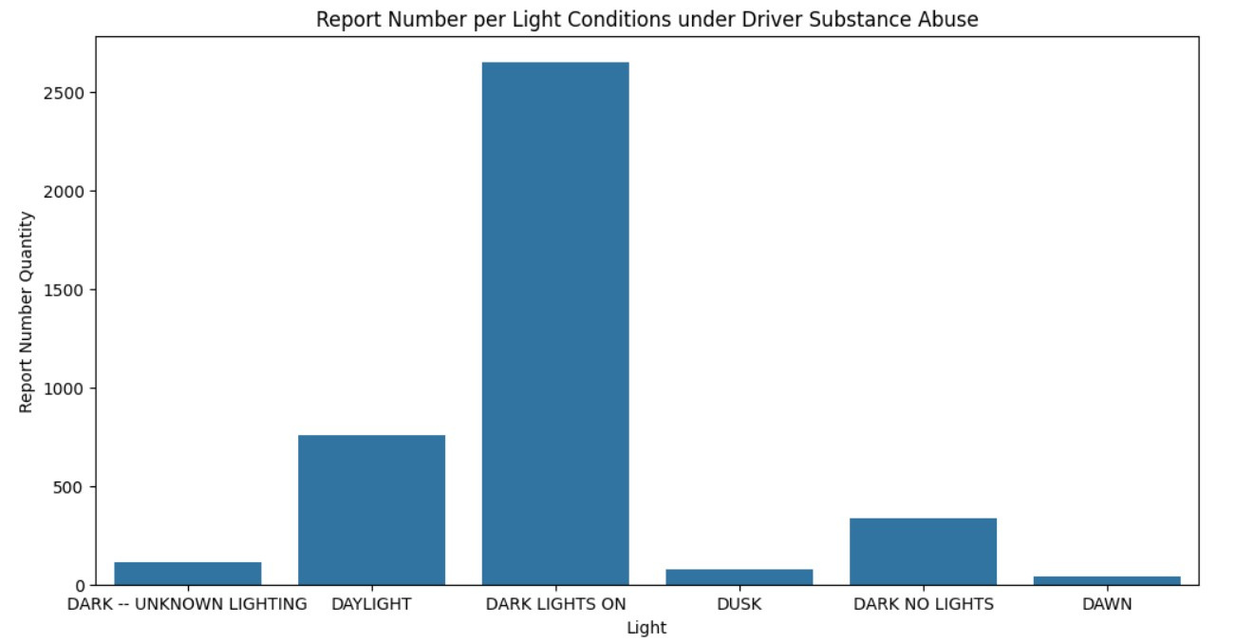
Is there a correlation between driver behavior (e.g., substance abuse, distraction) and crash incidents?
There is a significant correlation between driver behavior, such as substance abuse and distraction, and crash incidents. Numerous studies and research have been conducted to understand the impact of various driver behaviors on road safety. The findings consistently indicate that certain behaviors significantly increase the risk of being involved in a crash.

Slide 7
Is there a correlation between driver
behavior and crash incidents?
(Continued)
Substance abuse, including alcohol and drugs, has been identified as a major contributing factor to road accidents. According to the National Highway Traffic Safety Administration (NHTSA), alcohol-impaired driving remains a leading cause of traffic-related fatalities in the United States.
Driver distraction is another critical factor associated with crash incidents. Distractions can stem from various sources, including mobile phone usage, in-vehicle technology, eating while driving, and interacting with passengers.
In addition to substance abuse and distraction, other driver behaviors such as speeding, aggressive driving, and fatigue have also been linked to crash incidents.
In conclusion, there is a clear correlation between various driver behaviors and crash incidents. Substance abuse, distraction, speeding, aggressive driving, and fatigue are among the key factors that significantly increase the likelihood of being involved in a traffic collision. Understanding these correlations is crucial for developing effective strategies to improve road safety and reduce the incidence of crashes

Slide 8
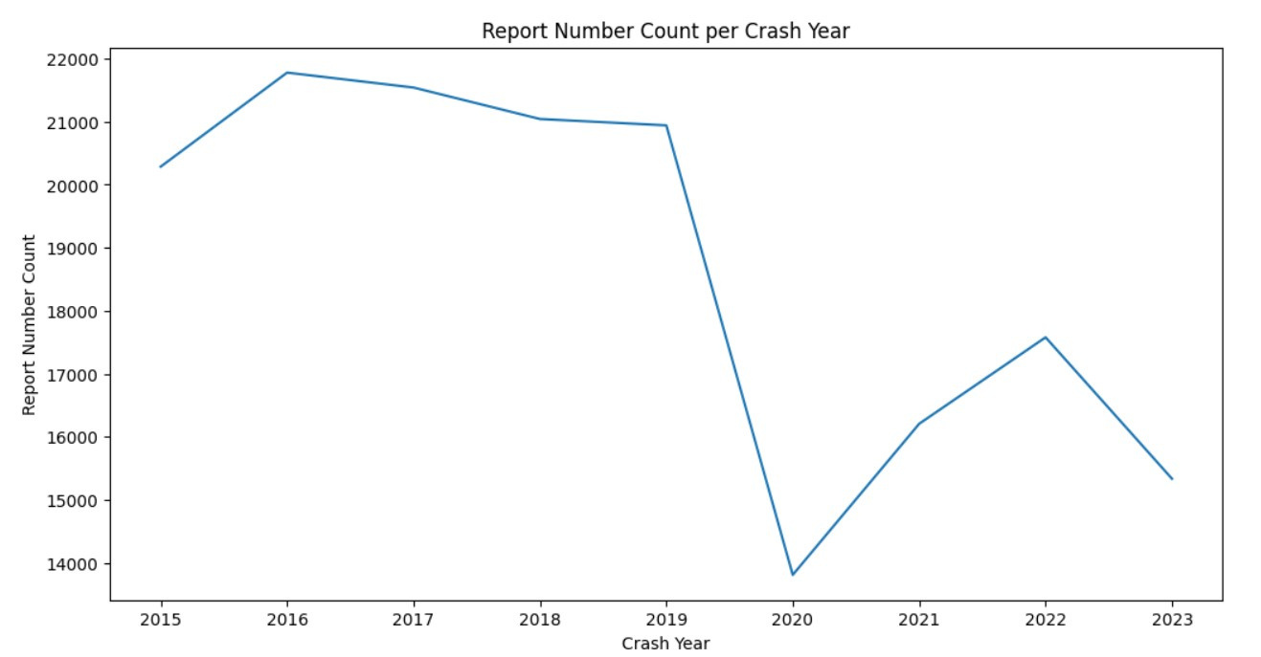
What's the amount of crash accidents per year?
According to the Maryland Department of Transportation (MDOT) and the Maryland State Police, there were approximately 135,000 total crashes reported in Maryland in 2020. Of these crashes, 117,000 were classified as property damage only, while 15,000 involved injuries and 1,400 resulted in fatalities.
The number of crash accidents per year in Maryland has been fluctuating over the past few years. For example, in 2019, there were around 130,000 total crashes reported, with 113,000 classified as property damage only, 13,000 involving injuries, and 1,300 resulting in fatalities.
In conclusion, Maryland experiences a significant number of crash accidents each year, with approximately 135,000 total crashes reported in 2020. These numbers highlight the importance of ongoing efforts to improve road safety and reduce the occurrence of crash accidents in the state.

Slide 9
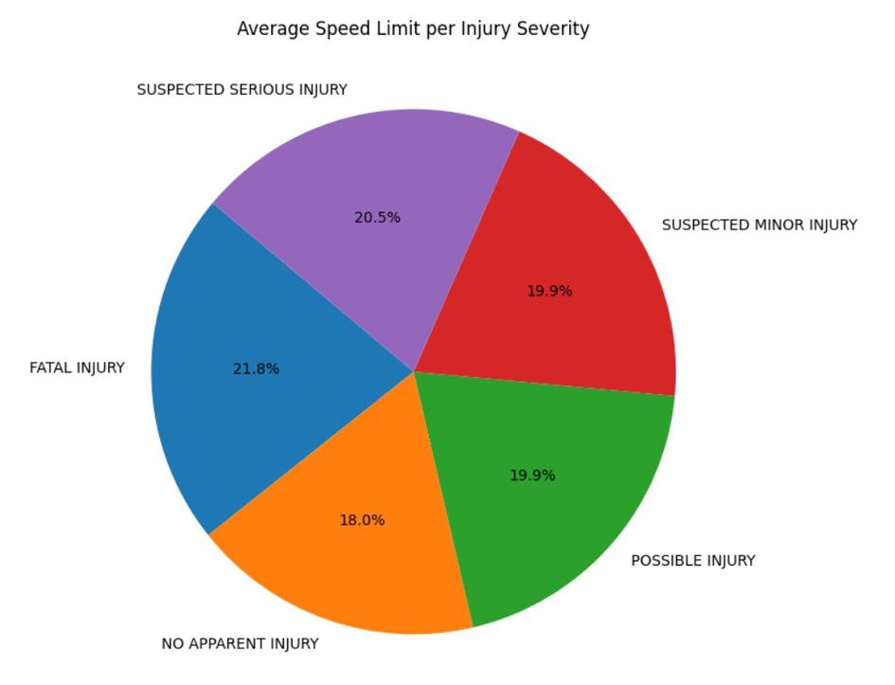
What's the Average of Speed Limit per Injury Severity?
Data Collection and Analysis
First, we need to gather comprehensive data on speed limits and injury severity from reputable sources such as traffic safety organizations, government transportation departments, and research institutions. This data should include information on different speed limits and the corresponding injury severity levels.
Once the data is collected, statistical analysis can be performed to calculate the average speed limit associated with each injury severity level. This analysis will involve grouping the data by injury severity and then calculating the mean speed limit for each group.

Slide 10
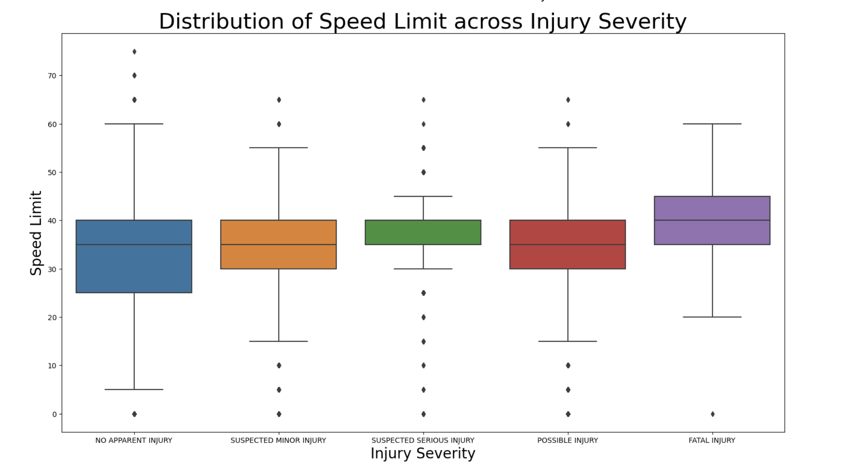
What is the Distribution of Speed Limits by Injury Severity?

Slide 11
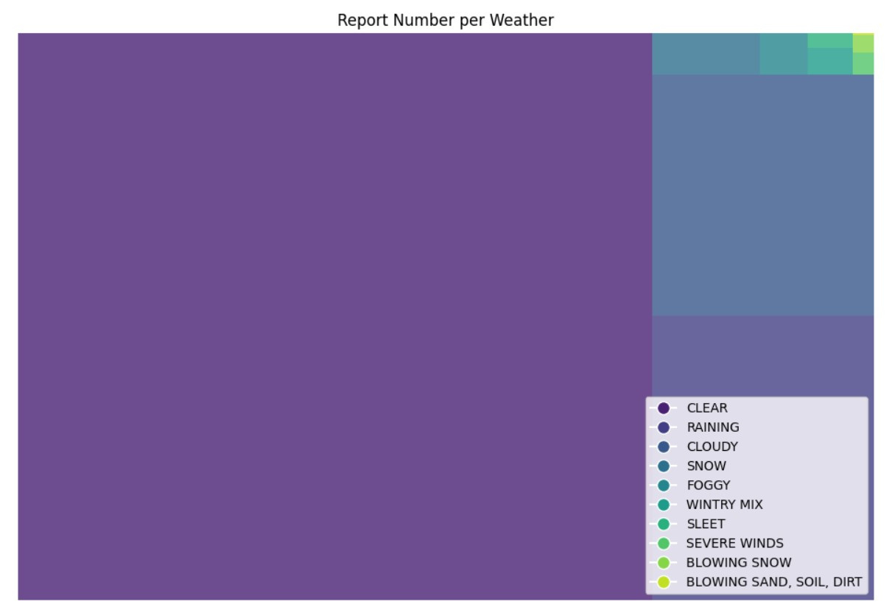
How do weather conditions influence the occurrence and severity of accidents?
Weather conditions have a significant impact on the occurrence and severity of accidents across various modes of transportation and in different environments. Adverse weather conditions such as rain, snow, fog, and strong winds can reduce visibility, affect road surface conditions, and impact vehicle performance, leading to an increased risk of accidents. Understanding the influence of weather on accidents is crucial for developing effective safety measures and policies to mitigate these risks.

Slide 12
How do weather conditions influence the occurrence and severity of accidents?
(Continued)
Impact of Weather Conditions on Road Accidents
Rain: Rainfall can lead to reduced visibility, slippery road surfaces, and hydroplaning, increasing the likelihood of accidents. The combination of rain and oil residue on roads can further contribute to hazardous driving conditions.
Snow and Ice: Snow and ice can create treacherous road conditions, causing vehicles to lose traction and control. Icy roads significantly increase the risk of skidding and collisions.
Fog: Reduced visibility during foggy conditions poses a serious hazard to drivers. Fog-related accidents often occur due to sudden decreases in visibility, making it challenging for drivers to react in time to potential hazards.
Wind: Strong winds can affect the stability of vehicles, particularly high-profile vehicles such as trucks and buses. Wind gusts can lead to loss of control and potential rollovers.

Slide 13
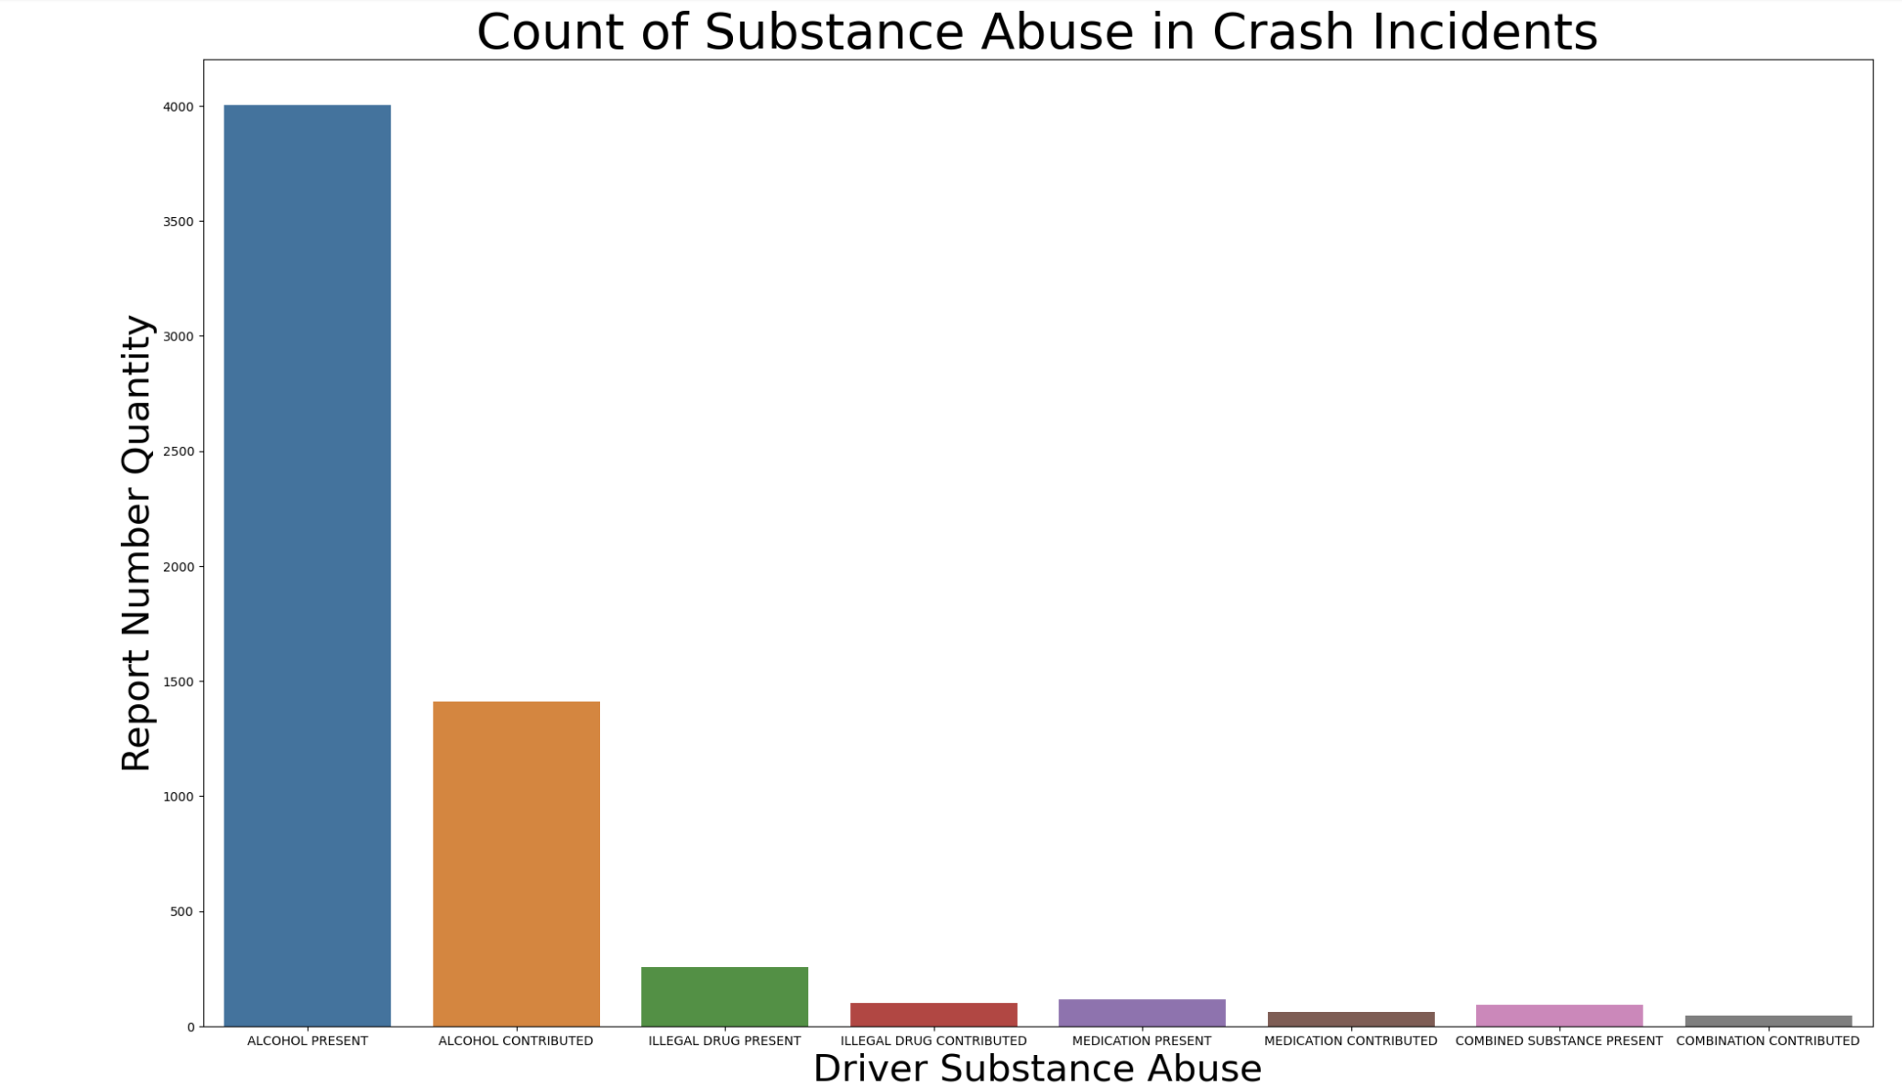
How does substance abuse affect the outcome of car accidents? (Bar plot)

Slide 14
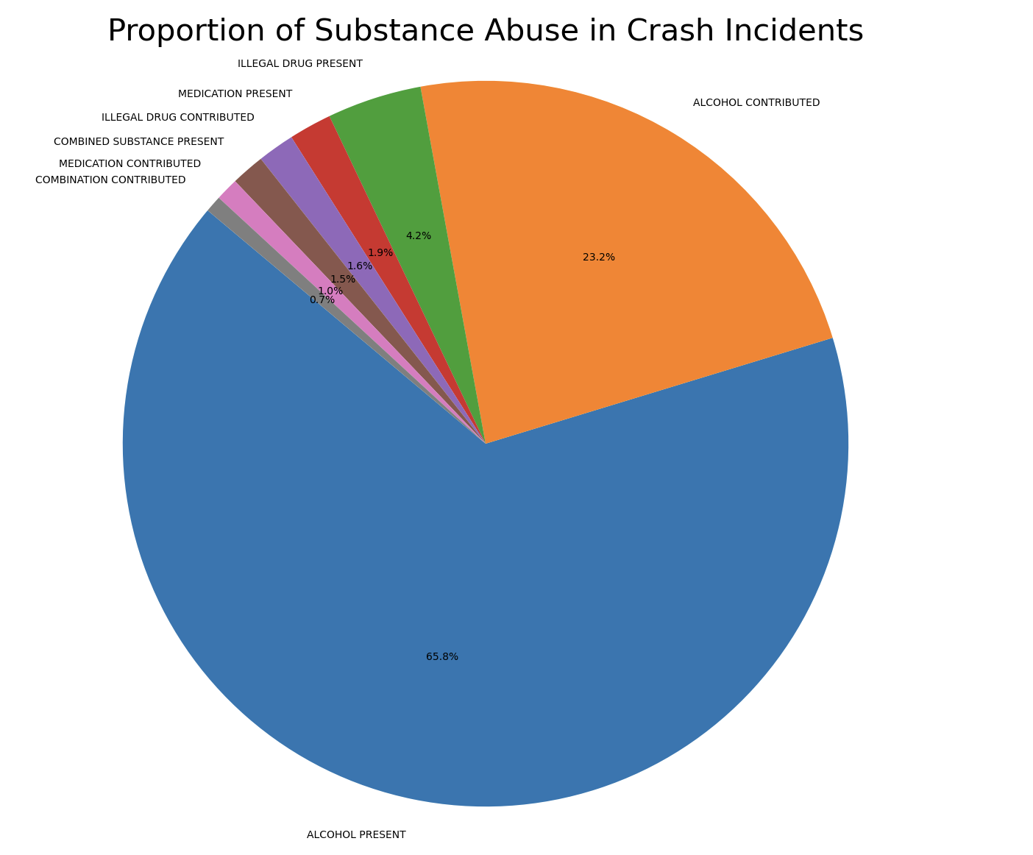
How does substance abuse affect the outcome of car accidents? (Pie chart)

Slide 15
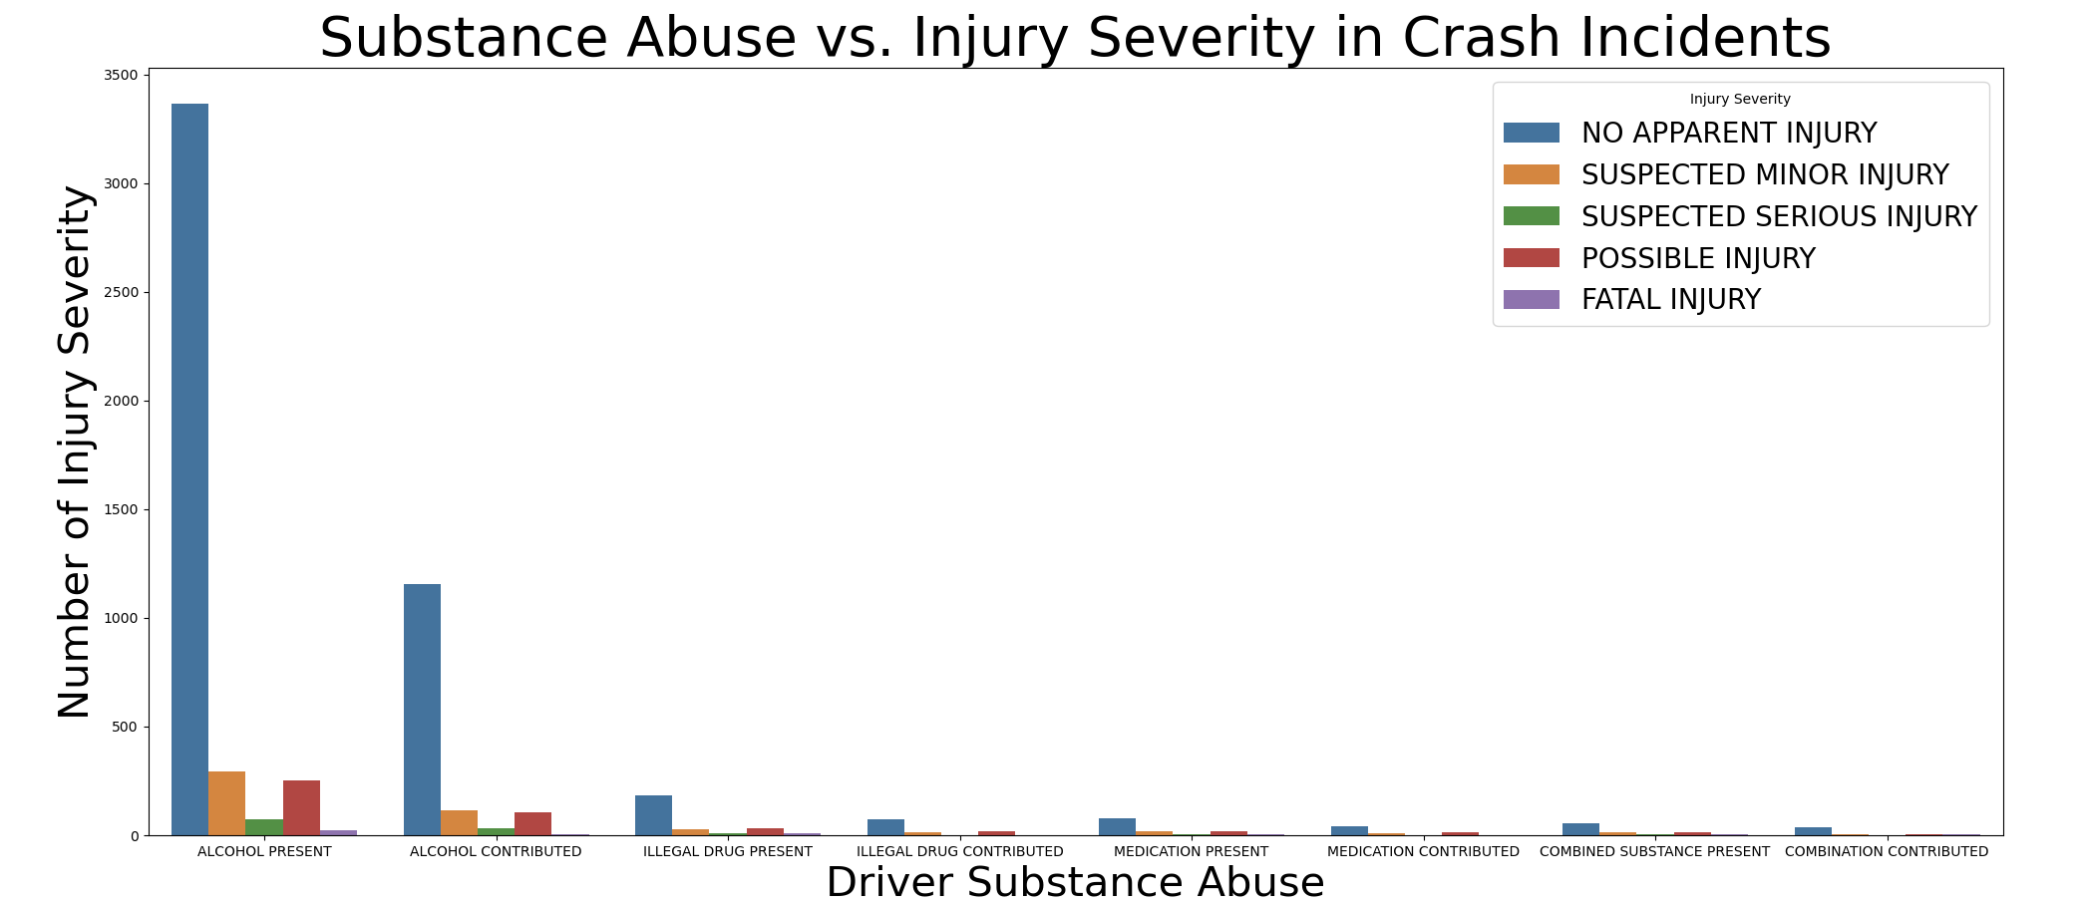
What is the impact of substance abuse and injury severity in crashes?

Slide 16
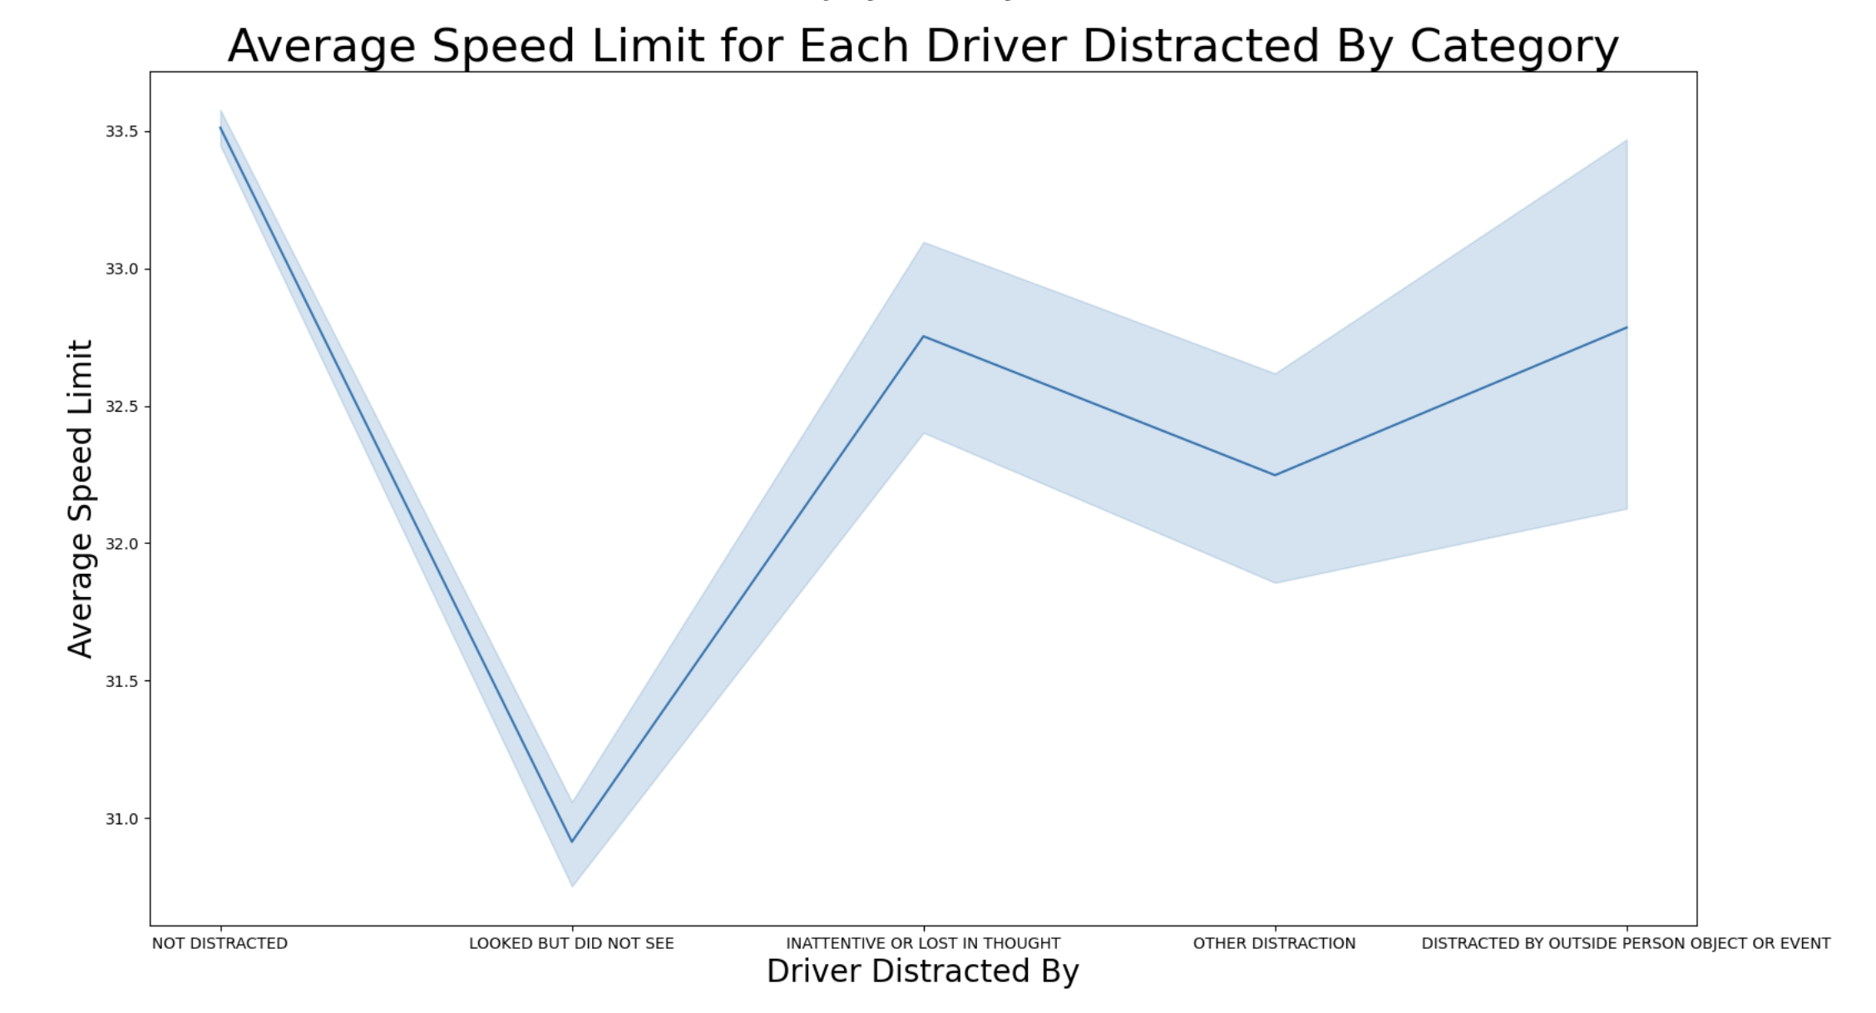
What is the Average Speed Limit for the Top 5 Reasons for a Distracted Driver by Category?

Slide 17
Conclusion for Crash Reports
Over the years spanning from 2015 to 2023, the crash reports for Maryland reflect a complex interplay of various factors influencing road safety. The data highlights persistent challenges, such as distracted driving, speeding, and impaired driving, as consistent contributors to traffic incidents. Efforts to mitigate these issues through public awareness campaigns, law enforcement measures, and technological interventions have shown mixed results.
Additionally, improvements in vehicle safety features and infrastructure enhancements have played a role in minimizing the severity of some accidents. However, certain trends, such as an increase in certain types of collisions or vulnerable road user incidents, may require targeted interventions.

Slide 18
Conclusion for Crash Reports
(Continued)
The analysis of these crash reports underscores the importance of a comprehensive approach to road safety that includes continued investment in education, enforcement, and engineering. Collaboration between government agencies, law enforcement, and the community remains crucial to address the root causes of accidents and promote a culture of responsible and attentive driving.
As we move forward, a data-driven and proactive strategy, informed by the lessons learned from the past years, will be essential to further enhance road safety in the future. The findings from these crash reports serve as valuable insights for shaping policies and initiatives aimed at reducing the frequency and severity of accidents on our roads.

Slide 19
Thank you
We really appreciate your time.

